Slide 1
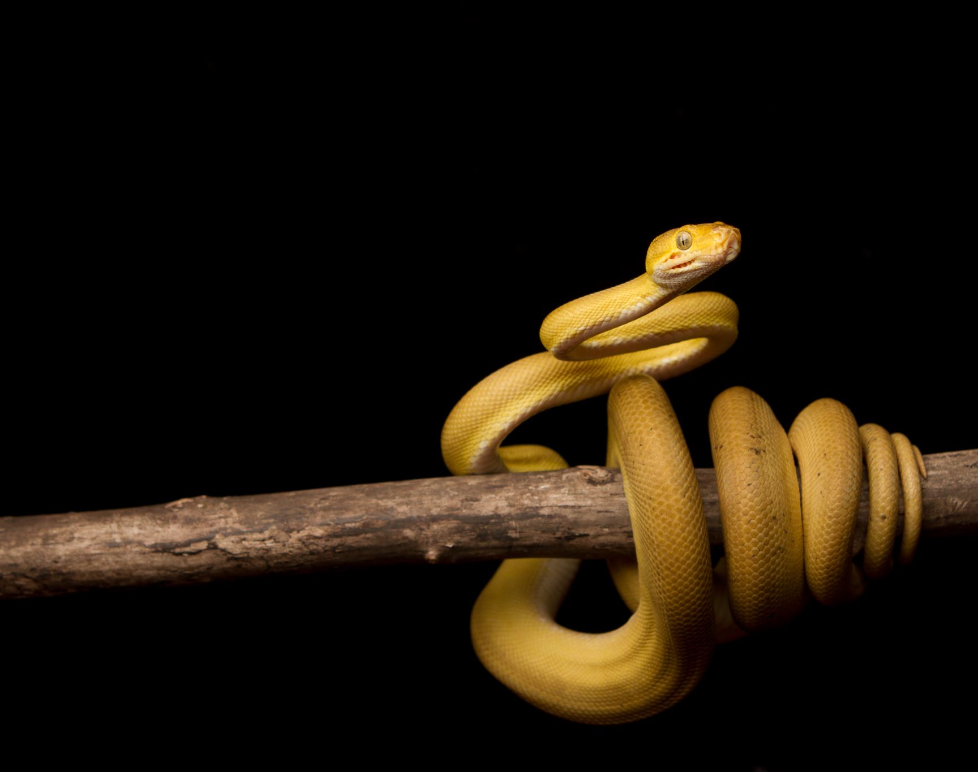
What’s New in Python 3.12
Friendly Exceptions, f-string enhancements, and less Setuptools

Slide 2
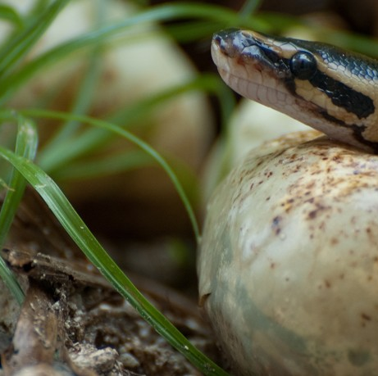
Python 3.12 is Almost Out!
As of today (2023-07-06), Beta 3 is out with the first release candidate out at the end of the month
3.12.0 should be out on 2023-10-02

Slide 3
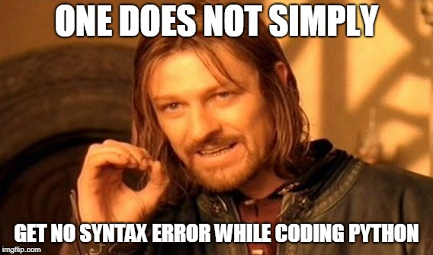
Improved Error Messages
Telling a user that they have a NameError, SyntaxError, or ImportError is not very helpful
Instead, let’s give a suggestion on how to fix the error!

Slide 4
Improvements to f-strings
Use quotes inside of the f-string expression
Nesting of f-strings within f-strings
Special characters, multi-line expressions, and comments

Slide 5

Remove Distutils, Stop Bundling Setuptools
Distutils is now removed
Setuptools is no longer installed by default in a virtualenv, so packages need to start declaring it as a dependency if they use a setup.py

